Slide 1
RESEARCH BASED LEARNING
“Faster and Safe Wireless Communication Network Using LiFi”
GUIDED BY: PROJ THOMAS ABRAHAM J V
PRESENTED BY: SHUBHAM GUPTA

Slide 2
INTRODUCTION TO LiFi
LiFi: Light Fidelity.
LiFi is high speed bidirectional network and mobile communication of data using light.
LiFi is designed to use LED light bulbs similar to those currently in use in many energy–conscious homes and offices.
LiFi comprise of multiple bulbs that form a wireless network, offering a substantially
similar user experience to WiFi using light spectrum.
LiFi bulbs are outfitted with a chip that modulate the light imperceptibly for optical data
transmission.
LiFi data is transmitted by the LED bulbs and received by photoreceptors.

Slide 3
OBJECTIVE
The objective is to show how LiFi works through a working
model and with that model make a use of real life
application

Slide 4
RESEARCH SCOPE
Research scope of my model is that with the help of LiFi we can
improve the network speed .
LiFi can become very helpful for overcome the drawbacks of WiFi.
LiFi provides a great solution as it uses optical spectrum instead of radio spectrum .

Slide 5
COMPONENT FOR AUDIO TRANSMISSION
LED Bulbs
Solar Panel
Wires
220 Ohm Register
Speaker
Laptop or Phones
9 Volt Battery
Aux Cables

Slide 6
COMPONENTS FOR ARDUINO TRANSMISSION
Arduino Unos
laptops or PCs
100 / 220 Ohm Register
Breadboards
LED Bulbs
LDR
Connection Wires
Connection Cable
SOFTWARE
Arduino IDE

Slide 7
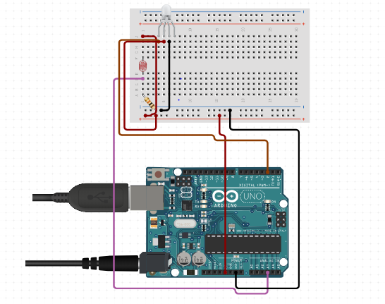
Circuit Diagram of Arduino

Slide 8
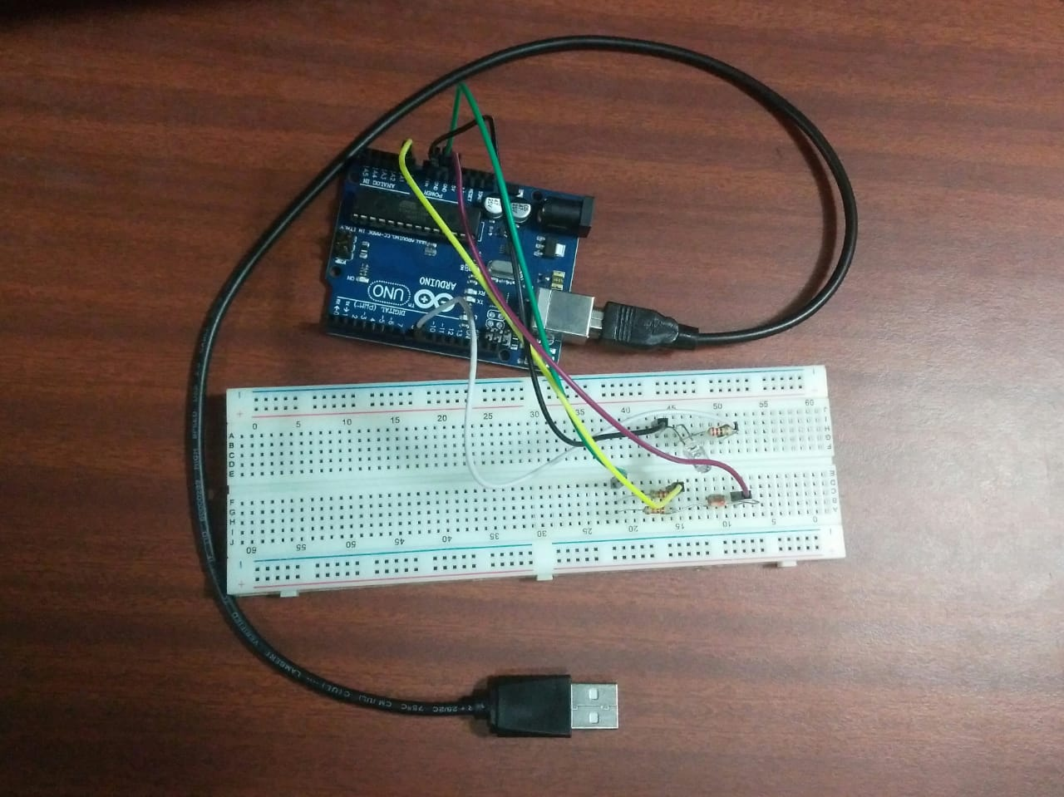
Text Transmission Model

Slide 9
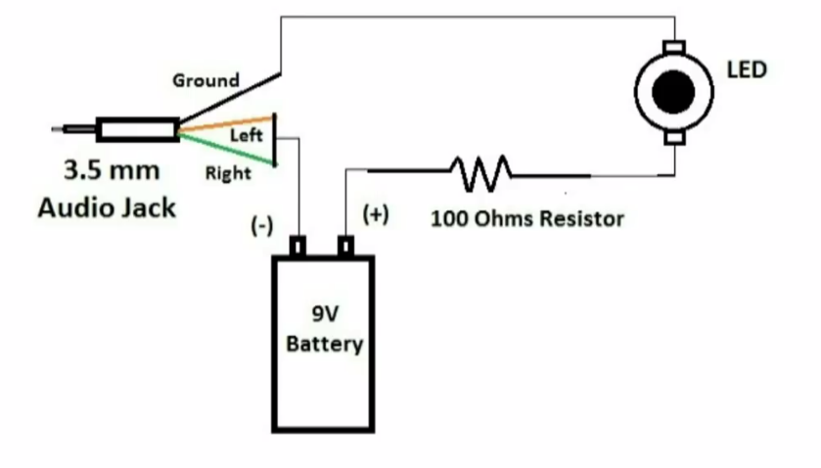
Circuit Diagram Audio Transmission

Slide 10
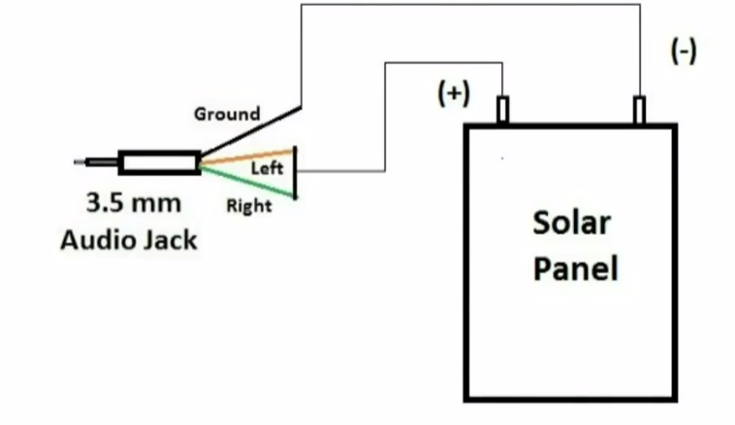
Circuit Diagram Audio Receiver

Slide 11
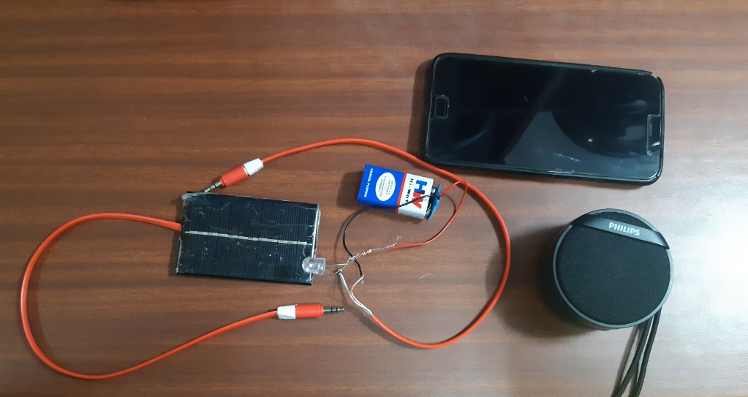
Audio Transmission Model

Slide 12
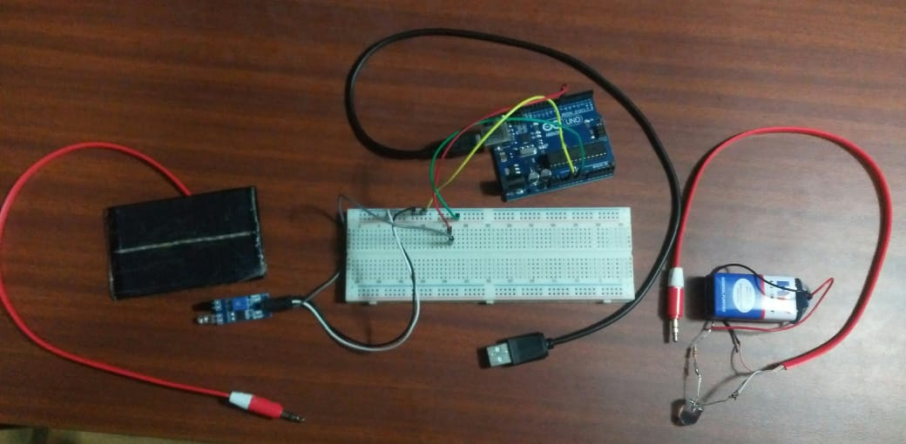
Blind Indoor Navigation System Model

Slide 13
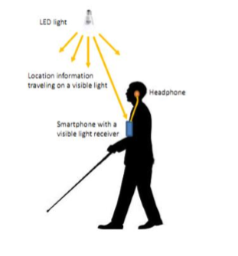
Blind Indoor Navigation System

Slide 14
IMPLEMENTATION
const int LED1=9;
const int LDR1=0;
int level;
const int threshold=150;
void setup() {
pinMode (LED1,OUTPUT);
Serial.begin(9600);
}

Slide 15
void loop() {
while(1)
{
digitalWrite(LED1, HIGH);
level= analogRead(LDR1);
if (level < threshold){
Serial.println("NO DATA");
}
else{
Serial.println("DATA IN");
}
delay(1000);
}
}

Slide 16
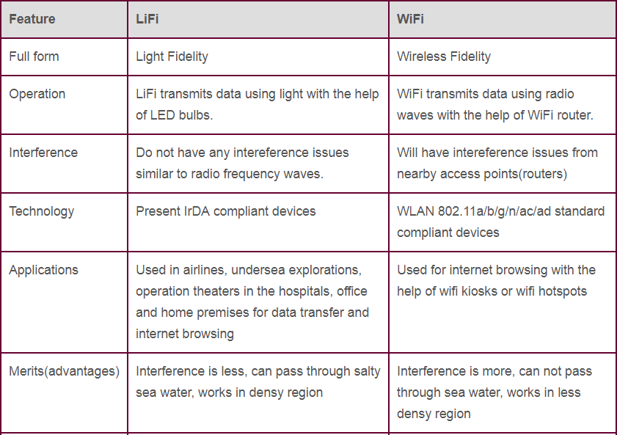
Comparison between LiFi & WiFi

Slide 17
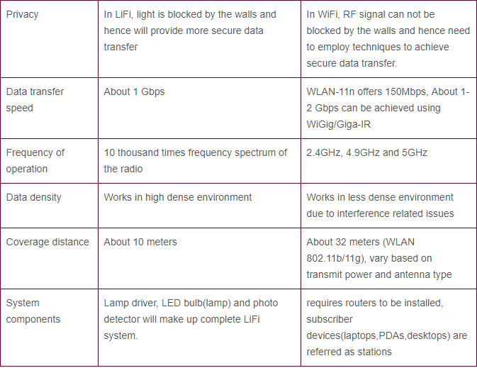
Continued..

Slide 18
Conclusion
Overcomes the limitations of radio spectrum.
High speed of 10Gbps can be achieved.
If this technology can be put into practical use, every bulb
can be used something like a WiFi hotspot.
This may solve issues such as the shortage of radio
frequency bandwidth.
LiFi is enabled by advance transmission technologies

Slide 19
REFERENCES
What is LiFi?( Harald Haas), Member, IEEE, Liang Yin, Student Member, IEEE, Yunlu Wang, Student, IEEE, and Cheng Chen, Student, IEEE.
LiFi: Conceptions, Misconceptions and Opportunities (Harald Haas). LiFi Research and Development Centre, The University of Edinburgh, Edinburgh EH9 3JL,
UK, h.haas@ed.ac.uk.
Coexistence of WiFi and LiFi Toward 5G: Concepts, Opportunities, and Challenges (Moussa Ayyash, Hany Elgala, Abdallah Khreishah, Volker Jungnickel, Thomas Little, Sihua Shao, Michael Rahaim, Dominic Schulz, Jonas Hilt, and Ronald Freund).
Security for 5G Mobile Wireless Networks : DONGFENG FANG1, YI QIAN (Senior Member, IEEE), AND ROSE QINGYANG HU , (Senior Member, IEEE) Department of Electrical and Computer Engineering, University of Nebraska–Lincoln, Omaha, NE 68182, USA

Slide 20
THANK YOU

